Slide 2
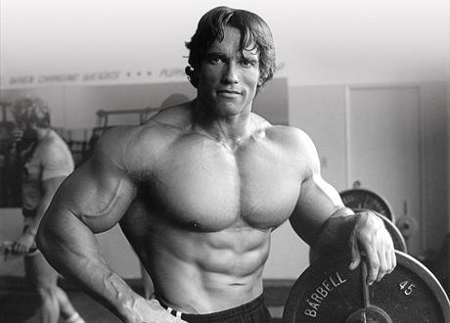
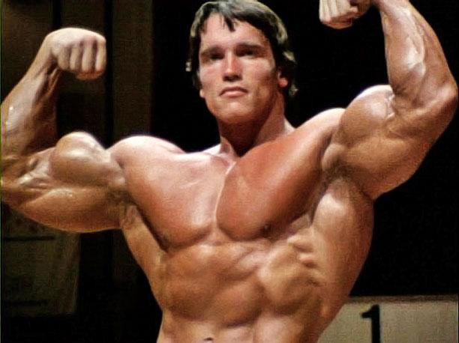
Models
[Found at: http://www.phootoscelebrities.com/celebrities/arnold-schwarzenegger/]
Notes:
Brent /\
|

Slide 3
Models and Prototypes
Brent Krieger, Jonathan Romrell, Joshua Jolley, Bruce Niendorf
Notes:
Whole Team

Slide 4
Method Explanation
Providing a representation of the project to a stakeholder in order to elicit requirements.
Notes:
Jonathan

Slide 5
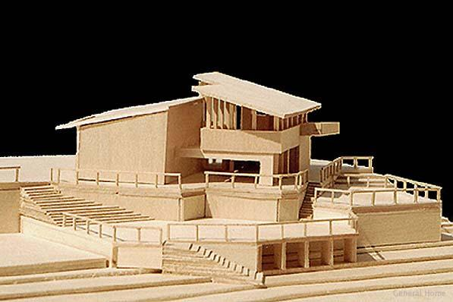
Model
A model of a software system is an incomplete, or not to
scale, example of a system
Communicates shared
understanding
Elicits additional requirements
Demonstrates conflicting requirements
Found at: http://www.generalhome.net/projects/architectural
_scale_model_malibu_home.htm
Notes:
Jonathan

Slide 6
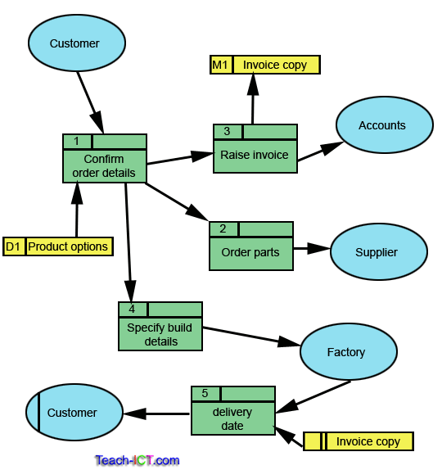
Model Examples
Data flow diagrams
Statecharts
Use cases
Sequence Diagrams
Found at: http://www.teach-ict.com/as_a2_ict_new/ocr/A2
_G063/331_systems_cycle/analysis_tools/miniweb/pg10.htm
Notes:
Jonathan

Slide 7
Prototype
Prototyping is a form of modeling that not only describes a system, but attempts to demonstrate some system functions
High or low fidelity
Verify stakeholder needs
Clarify unclear or missing requirements
Notes:
Jonathan
Low fidelity prototyping is comparable to, and serves a similar purpose as, other types of modelling. High fidelity prototypes occur later on in development, and are much more expensive

Slide 8
Advantages
Prototyping the system will likely elicit further requirements from stakeholders and users
Low-fidelity prototypes are cheap and generally easy to make
Notes:
Bruce

Slide 9
Disadvantages
Stakeholders may feel the project is close to completion, or that changes are easy
Stakeholders might feel limited
Cost - Time and money
Notes:
Bruce

Slide 10

See It In Action
[Found at: https://www.youtube.com/watch?v=lXNu0VBVCUc#t=133]
Notes:
Jolley Start at 2:13. End at 3:17

Slide 11
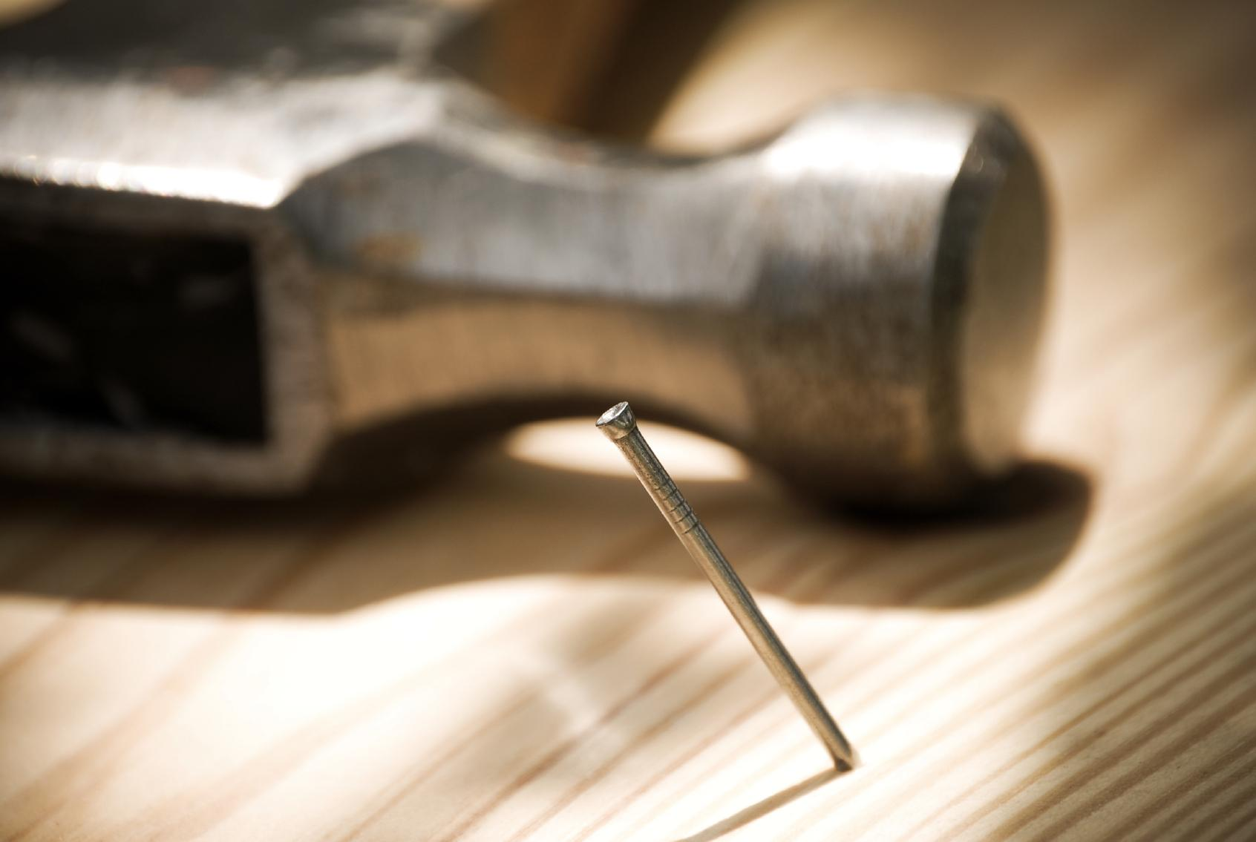
When To Use
If your stakeholders:
Offer conflicting requirements
Struggle to express requirements
Early on:
Simple, low fidelity models
Later on:
High fidelity prototypes
Found at: http://tucsonbdg.com/wp-content/uploads/
2013/01/Hammer-and-Screw.jpg
Notes:
Jolley

Slide 12
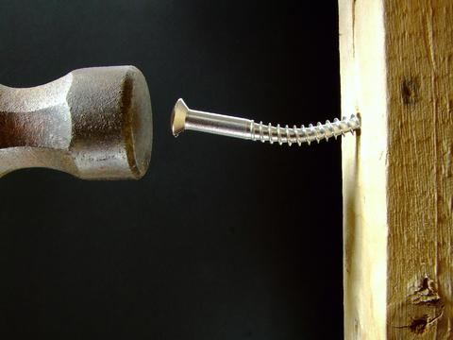
When Not To Use
If the system is:
of no predictable form
large or complex
If the user:
changes their mind a lot
likes WYSIWYG (what you see is what you get)
Don’t get caught up in design
Found at: http://tucsonbdg.com/wp-content/uploads/2013
/01/Hammer-and-Screw.jpg
Notes:
brent

Slide 13
Effectiveness (In Extracting Requirements)
Very effective with:
groups of technical stakeholders
early in the elicitation process
Notes:
brent

Slide 14
Questions?
Prototyping and Modeling
High and Low Fidelity
Advantages and Disadvantages
When To Use and When Not To Use
Effectiveness
Notes:
All

Slide 15
Demonstration
Please sit with your project group now
Notes:
Have the groups generate a low fidelity models/prototypes using the whiteboard or paper and pencil
Presenters behave as (non-technical?) stakeholders and suggest features that could be improved or clarified by using a prototype

Slide 16
Sources
http://www.bridging-the-gap.com/using-wireframes-or-prototypes-to-elicit-analyze-and-validate-software-requirements/
Cleland-Huang [117]
Sawyer [131-132]

